Slide 1
DevOps POV on Omni Channel platform for BJ’s
May 2016

Slide 2
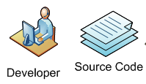


Current State Overview
Overview:
The BJ’s Omni Channel platform is a WCS and Sterling based platform developed to support B2C Ecommerce
Dev Technologies: IBM WCS, Sterling, Endeca, Java, JavaScript, Shell scripts, Angular JS, HTML
There are 4 Linux based Environments to Support (Dev :11 servers, QA: 14 servers, Perf: 11 Server) and 1 Linux based Environment for Production :12 servers.
Key Challenges:
A high level discussion was carried out with the application development & support team over few meetings based on which following challenges were identified.
Weak Source code Management process hindering Release promotion due to ineffective branching and Merging
Incomplete CI (Continuous Integration) process with code review and Test Automation to propagate build and deployments leading to delay in delivery
Adhoc release and Environment Management without a dedicated DevOps Team
No artifact traceability due to lack of tools for artifact Management.
Tools Landscape:
Version Control : RTC
Incidents : SOS (In House)
IDE : RAD
Change Control : Service Now
Defect Mgmt. : RQM
Build : IBM Build Scripts
Testing : RQM, BURP suite
Continuous
Integration : Jenkins
Monitoring : Tivoli
RAD
Build Server
Non Prod Environment
CI Deploy
QA
Performance
CI Build
RTC
Jenkins
Jenkins
Manual / Automated Testing
Production Environment
Prod
CI- Continuous Integration
Manual Deploy

Slide 3
Cognizant Findings & Recommendations
 | Service Area | Observation | DevOps Proposition
Version Control | Branching Strategy | Current branching process hinders QA promotion and parallel releases | Implement a branching strategy that ensure seamless parallel development and releases
CI -Build | Build Schedule | No scheduled automated build in any of the lower environment | Enable schedule regular automated builds
 | Build procedure | One Half Builds are manually build and deployed | Enable automated CI (Continuous Integration) jobs for One Half build and deployments
 | No Artifact Repository | Production deployments might be error prone and Artifact traceability is unavailable | Implement Repository management tool and enable traceability
Deployment | Production Deployments | Production deployments are carried out manually | Implement tool and process for automated production deployments
 | Database Deployments | Database changes are not version controlled and manually deployed | Implement version control for DB changes and tool enabled DB deployments
Testing | Unit Testing | Unit testing is carried out manually | Implement appropriate tool to integrate with CI (Continuous Integration) process and perform automated Unit testing.
 | Code Coverage | No code coverage testing | Implement code coverage tool and ensure better code quality

Slide 4
Cognizant Findings & Recommendations
 | Service Area | Observation | DevOps Proposition
Environment | Environment Booking System | No specific process or tools for environment booking and traceability | Establish Environment booking process
 | Environment Provisioning | Environments are manually provisioned | Implement configuration tool and enable automate environment provisioning
 | Production Logs | No alerting system and log tractability for troubleshooting | Enable stringent alerting mechanism and logging for proactive server maintenance
Process | Release Management | No Release Management Process / Tools | Implement Release management tools and enable release calendar and process
 | Roles and responsibility | Developers perform build and deployment activities | Onboard dedicated DevOps team to perform build and deployment to non Production and Production environments
 | Reporting Metrics | No metrics are generated from Jenkins | Generate report and make transparence across project stake holders

Slide 5
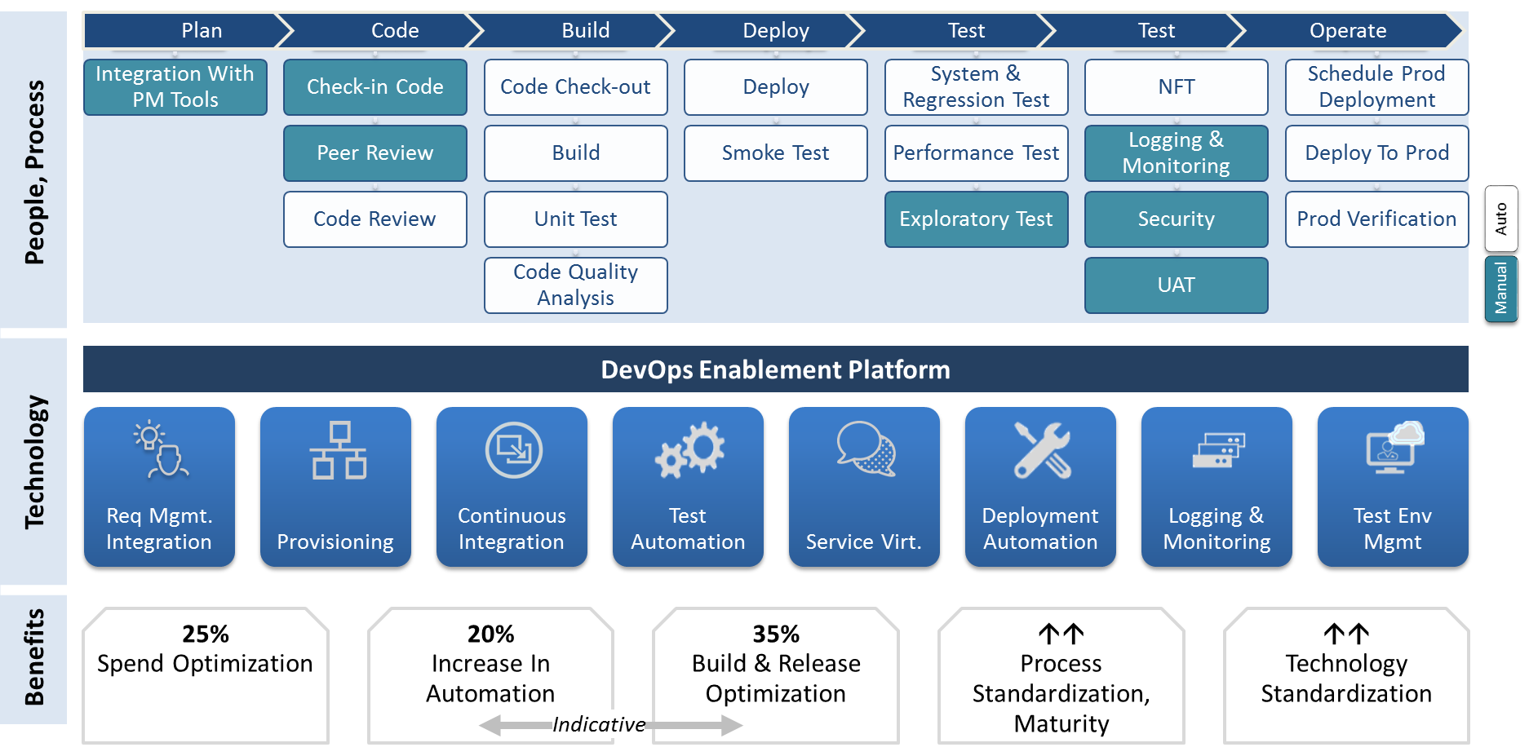
DevOps Enablement Service Towers

Slide 6












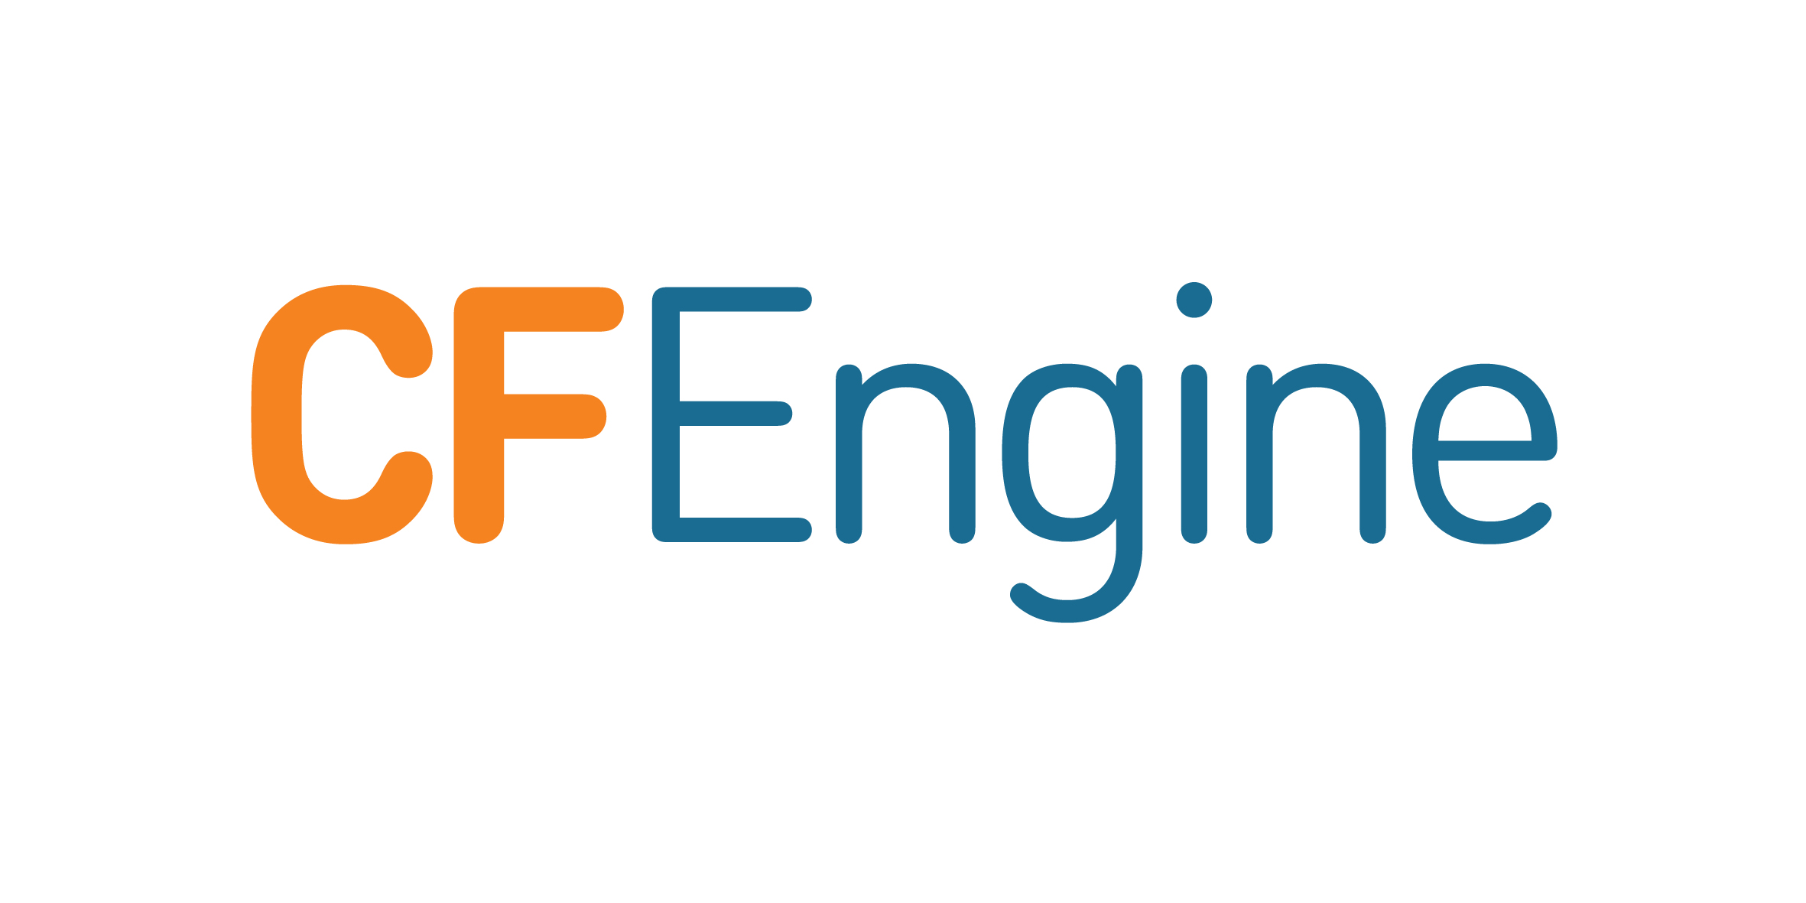




DevOps CI - Continuous Integration & Automated Deployment Approach - Indicative
Plan
code
Build
Deploy
Test
Operate
1
2
3
4
5
Business Analyst
Developers
Build Engineer
Quality Engineer
Deployment Engineer
Capture
Requirement
Check in/out with IDE
Execute Jenkins jobs
Execute Test scripts
Execute Deploy
6
Req tracking
Source control
CI - Build, Code Review, Unit Test, Deploy
Test Automation
Continuous Delivery
IBM Custom Build scripts
CI- Continuous Integration
Release Dashboard - Hygeia
Log Management and Monitoring
Production & DR
Proposed Tools - Licensed
Proposed Tools - Open source
QA
Performance
Archive

Slide 7

Environment Management
Environment Provisioning Phase | Environment Support Phase | Environment Change Mgmt. Phase
Developer / Tester
Health Check | Environment Status Reporting | Environment Currency
Request for Env
Service Request
Change Request
Incident
Requester
Requester
Developer / Tester
Developer /Capacity Team
Notify Env Booked
Define Env
Status
Service Request (SR)
Status
Change Request (CR)
Status
Incident (CR)
Status
De-provisioning Request (SR)
Assign / Create new
ILM
Request
Complete
Scheduling, booking
Service Request Coordination
Change Coordination
Service Request Coordination
Request
Complete
Request
Complete
Request
Complete
Request
Complete
Provision
SR support / Implementation
Change Implementation
Incident resolution / RCA
Release Resources
Service Request Complete
L3 / L4 support (out of scope)
Asset mgmt.
Capacity mgmt.
Configuration mgmt.
Utilization Reporting

Slide 8
Release Management Ecosystem
INPUT
Project Portfolio
Preventive Maintenance / Technology Refresh
Release Schedule
DEV
QA
Performance
PROD
Release Management Workflow
Release Policy
Release
Planning
Build / Configure - Release
Release Acceptance
Release Implementation Coordination
RELEASE MANAGEMENT
Design
Release
Prioritization
Post Release Verification Coordination
Release Validation
Release Communication
Release Activities - Dev
Release Activities – Testing & QA
Release Activities – Live
Release Calendar
Release Deployments
OUTPUT
ENABLERS
Better coverage for RM operations
Cyclical handover synergy across multiple service windows
Optimization based on existing toolsets and process levers.

Slide 9
Implementation Road Map - Indicative
The recommendation shall be implemented by deploying 2 dedicated SME distributed across onsite and offshore from DevOps as per the waves and timelines highlighted below:
Sr DevOps Engineer at Onsite - $ 125
DevOps Engineer at Offshore -$38
M1 | M2 | M3 | M4 | M5 | M6
Design Approval & Infra readiness
Understand the Application, Tools, Technology, Environment landscape and Data volume
Confirm Scope and Objectives
Approval on Tools recommendation and tool chain Integration
Readiness of Infrastructure for Implementation
End State Defined
ON- 1 OFF -1
Configuration of Jenkins
Installation of new proposed tools and Integration with proposed tools and validation
Setup Repository Management using Nexus OSS
Document the CI process and SCM best practices and guidelines
POC and Sign off
CI and Proposed tools Training to users
CI configuration – With available tools
ON- 1 OFF -1
Automated Deployment -uDeploy
Deployment Automation configuration
Implementation of Deployment in non Prod environment using UDeploy
Implementation of Automated Deployment in Production
Implement Environment Booking process
ON- 1 OFF -1
Log Management & Release Management Dashboard
CD Training to Deployment Team
Create SOP’s on Deployment and Monitoring process
Generate metrics and Reports and Hand off
Configure Release Management dashboard for metrics
Configure Log Management and Monitoring
ON- 1 OFF -1
Steady state and Hand OFF
Support Steady state BAU
Generate metrics and Reports and Hand off
CI- Continuous Integration
ON- 1 OFF -1

Slide 10
Resource Loading
Assessment Phase | Sr DevOps Engineer (Onsite) | DevOps Engineer (Offshore) | Roles & Rate /Hours
Due Diligence – M1 | 1 | 1 | Sr.DevOps Engineer( onsite) - $125 DevOps Engineer (offshore -$38
CI Configuration- M2 | 1 | 1
Deployment Automation –M3 | 1 | 1
Release Mgmt. Dashboard – M4 | 1 | 1
Steady state Handoff – M5 | 1 | 1
Pricing
Cognizant proposes to execute 5 weeks of implementation through a fixed price contract for $

Slide 11
Tangible Benefits
Automated and unattended build by creating static jobs with automatic and unit testing in Jenkins environments helps eliminate the wait period for testing and production ensuring optimal usage of development efforts
Reduce Production Deployment time by enabling automation and traceability through uDeploy and thereby improvement in Deployment time up to 30% .
End to End Traceability of artifacts and defects by Integrating Jenkins with RTC, Service now ,Nexus and uDeploy
Introduce and Integrate code review tool like SonarQube with Jenkins reduces manual efforts up to 30% and improves the code quality
Effort reduction and Quick turn around on environment provisioning through CF Engine
Better transparency and governance through Approval, metrics and Reports with usage of Hygeia for Release Management
Effective Log management and Application Monitoring through usage of tools such as Splunk & Tivoli

Slide 12
Assumptions and Dependencies
BJ's provides all the necessary infrastructure (Office space, Hardware and Software) for the onshore resources and firewall requests for offshore resources (if any) during design and Implementation
BJ's will identify key stakeholders, SMEs and ensure their availability during the design and Implementation phase
Access to the systems and infrastructure will be available to the Cognizant Team within 1 week from the start of the project. Delay in getting the access may change the project timelines
BJ's need to ensure the availability of Application owners, Process owners for all key meetings during the planning, design and Implementation
Costs for any special software and hardware required by Cognizant will be borne by BJ's

Slide 14
Appendix

Slide 15
How DevOps can make Agile more efficient
Objective
What Agile Demands
Focus Areas
Cognizant DevOps Solutions Levers & Benefits
A | Reduced build turnaround
B | Increased Release throughput
C | Increased Test Automation
D | Increase in Test Environments
E | Support multiple production releases
F | Measure feature success
G | Proactively monitor
Environments
Build & Deploy
Release
Production Support
Testing
DevOps
Enterprise Continuous
Delivery
Enterprise Release Management
Smart Environments
Feedback Amplification
Increase: Product velocity
Decrease: Time to market
product of each sprint should be (potentially) shippable
Improve: Customer experience, product resiliency
Enhance: Release confidence and stickiness
Reduce: Cost of testing, cost of environment, cost of infrastructure
Measure and share: Benefit of DevOps
Provide: Real time insights across the enterprise
DevOps @Cloud
Next Gen DevOps
Future-proof: Application infrastructure and application architecture

Slide 16
Case Study : DevOps Strategy Consulting For One Of The Largest Healthcare Companies
PROFILE
SOLUTION HIGHLIGTHS
Client is one of the largest Healthcare companies in US
Worked with different teams across different Projects to understand the As Is process.
Understood the existing platform / Process & Tools/Technology and how they are integrated together
Published key Findings / problematic areas like processes are ad-hoc, relying on effort intensive coordination; leading to delays and with a lot of opportunities to automate, streamline, optimize, improve quality and reduce cost) and tried to bring in industry best practices
Helped client refined and defined their DevOps vision for MDM platform with recommended tool chain integration and process
BUSINESS DRIVERS
Repetitive and error-prone manual build and deployment process
Lack of separate well defined QA or staging environments
No well-defined SCM policy
Lack of standardized build tools or processes
Late defect discovery
Lack of automation
BENEFITS/VALUE DELIVERED
Created very granular report highlighting major and minor problem areas
Socialize recommendations and help them build a business case
Created the customized DevOps target state
Highlighted cost benefits, scalability matrix
Created the target operating model to guide the client in achieve this transformation
Recommendation to rationalize the different tools used across DevOps
TOOLS LANDSCAPE
Stash/Git, JIRA, Crucible
Maven, Bamboo
Nexus, Clover
Chef, Splunk

Slide 17
Case Study : Enterprise DevOps For Largest Online Marketplace
PROFILE
SOLUTION HIGHLIGTHS
Client is an American multinational corporation and e-commerce company, providing consumer to consumer & business to consumer sales services via Internet.
Scalable Jenkins based continuous integration framework and tool chain integration
Continuous testing
Strict dependency matrix based deployment
Logging mechanism as strong feedback loop
BUSINESS DRIVERS
Short time to market
No downtime allowed
Need of Seamless, agile, automated delivery process
Need of strategic solution without losing focus on tactical initiatives
BENEFITS/VALUE DELIVERED
~1 minute deployment frequency
Zero production down time during release
Continuous deployment to entire production
Infrastructure efficiency is measured down to every asset level
CURRENT LANDSCAPE/STATE
50 million Line of code
100 billion database transactions per day
5 architectures. 3 technology stacks
8 development centers across the globe

